Slide 1
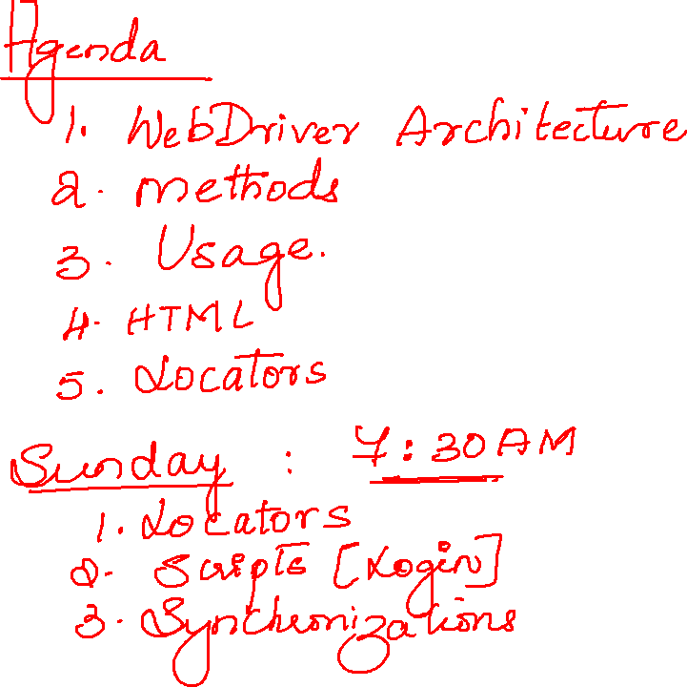

Slide 2

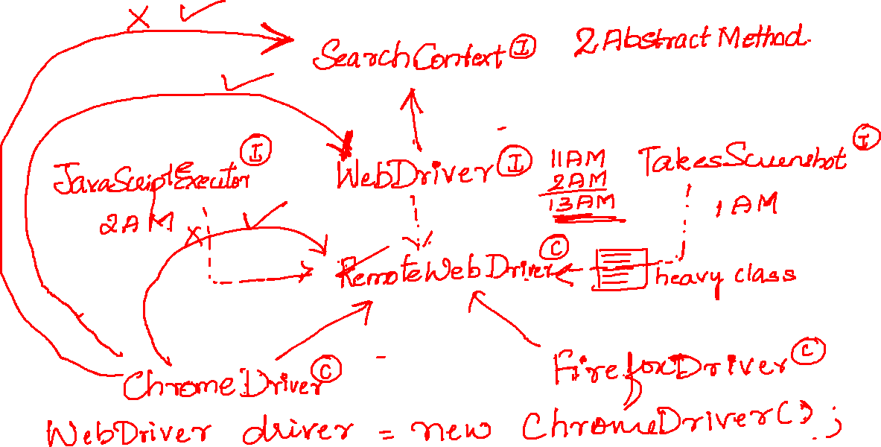


Slide 3
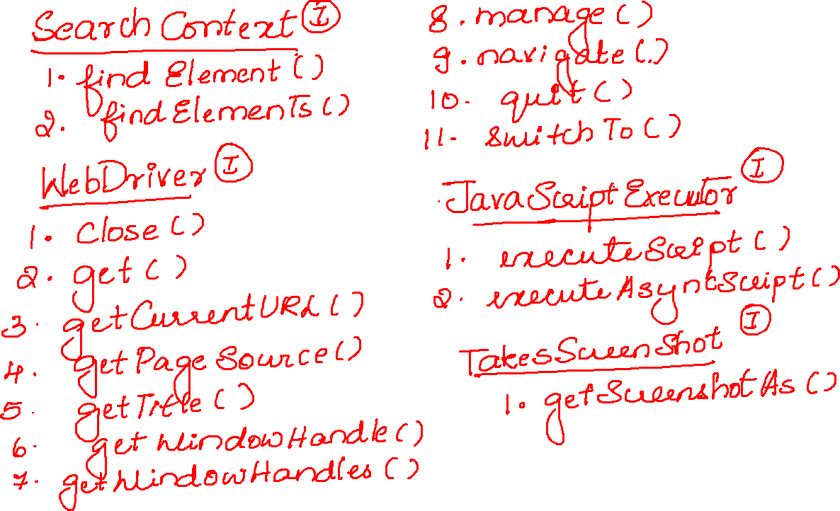

Slide 4
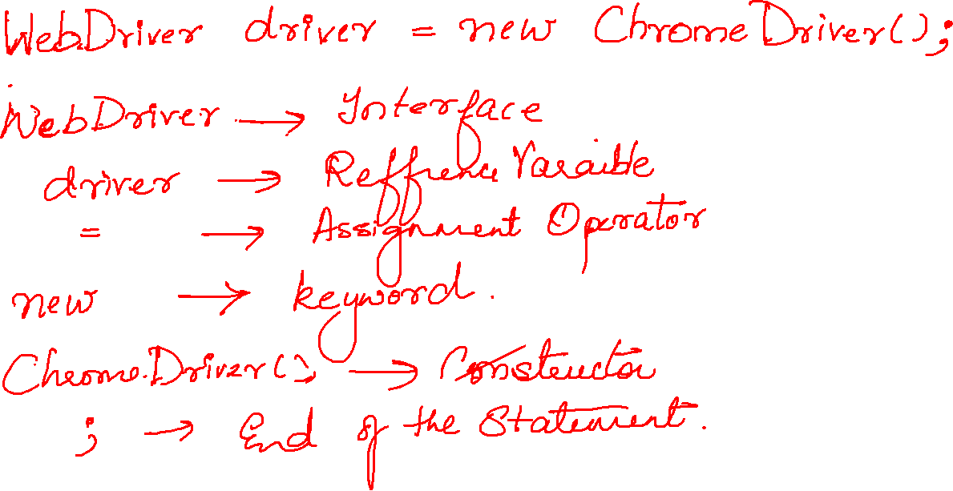

Slide 5


Slide 6
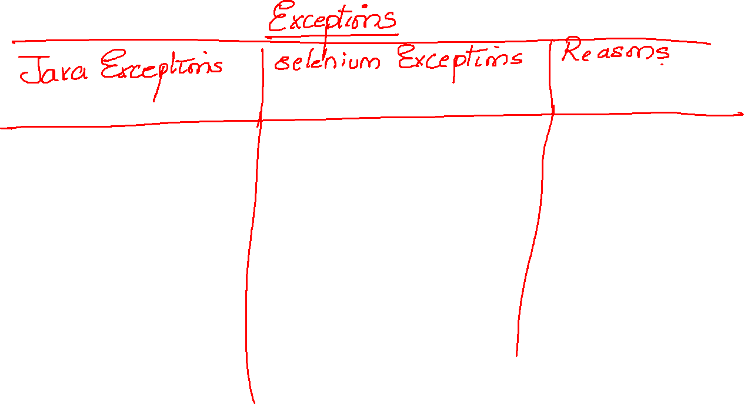

Slide 7
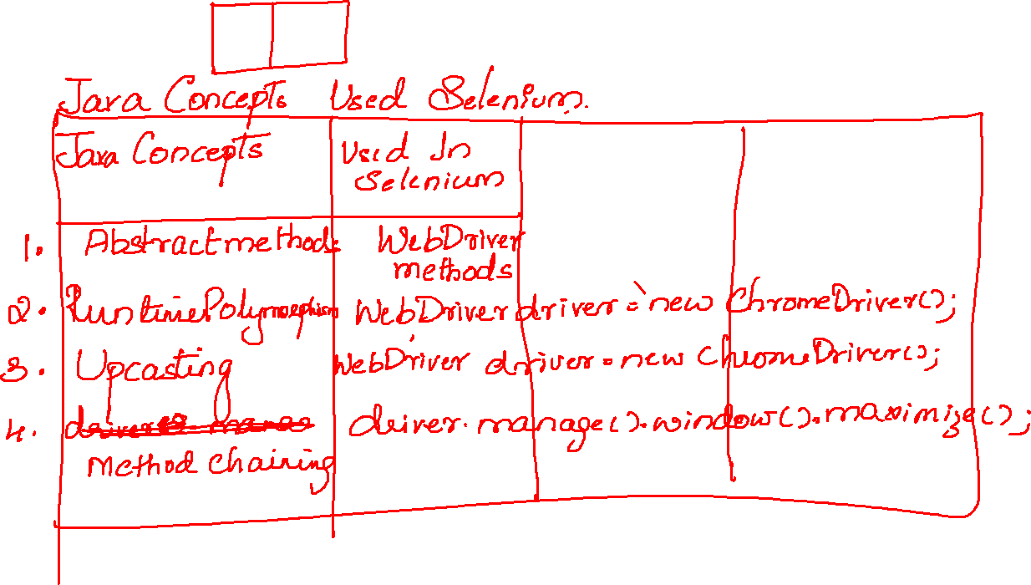

Slide 8


Slide 9
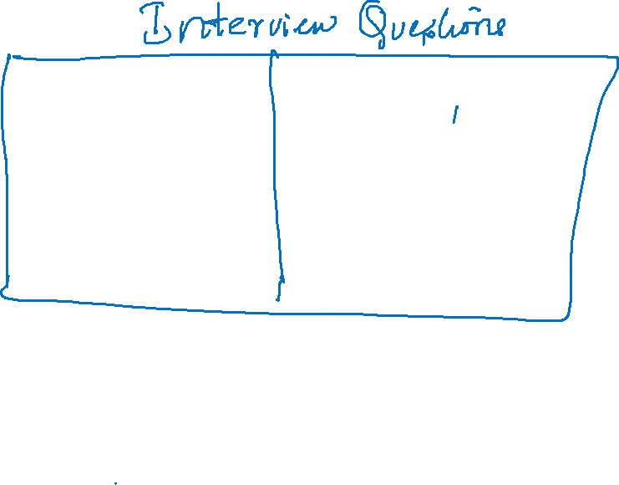


Slide 10



Slide 11
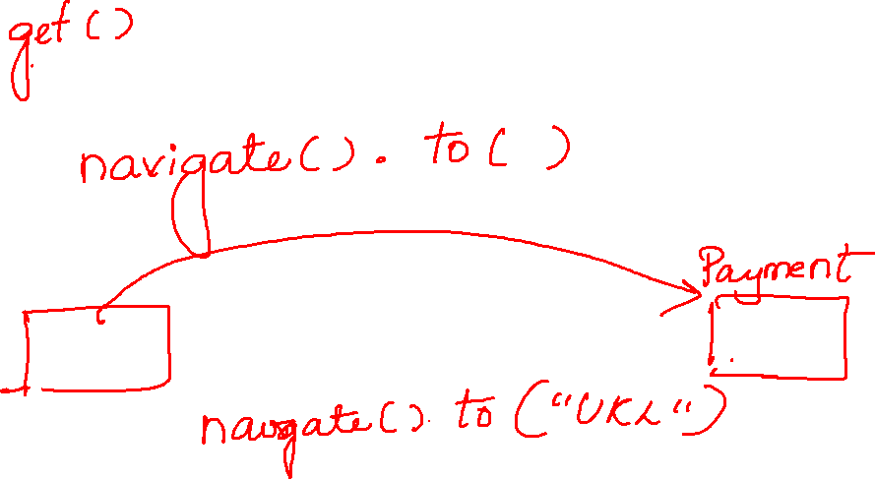

Slide 12
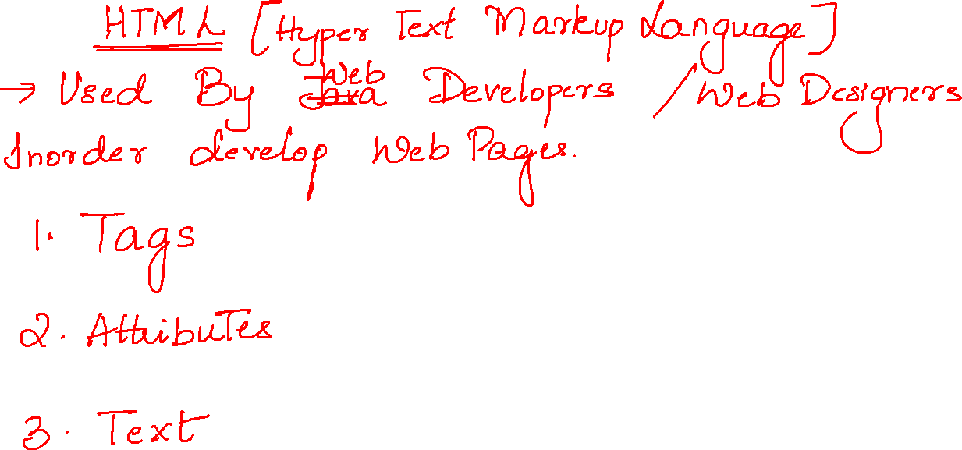

Slide 13
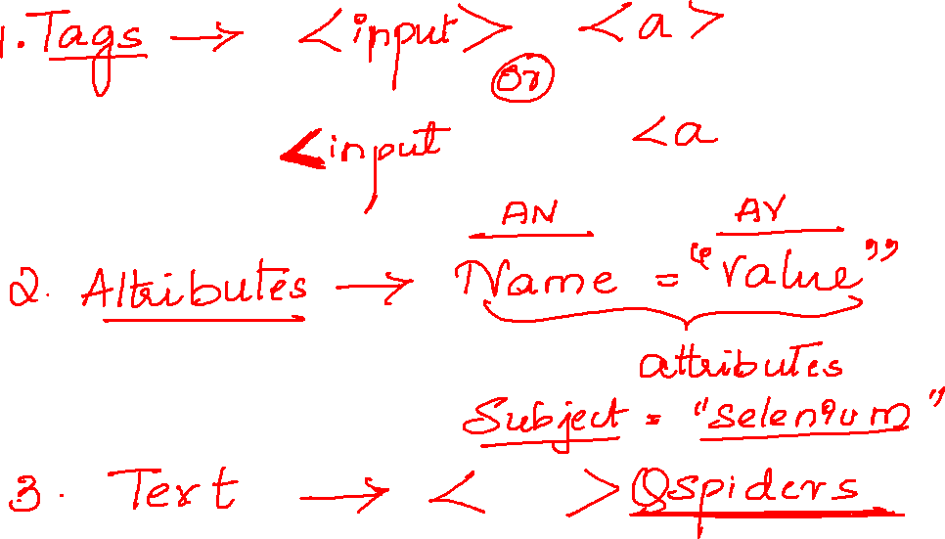

Slide 14
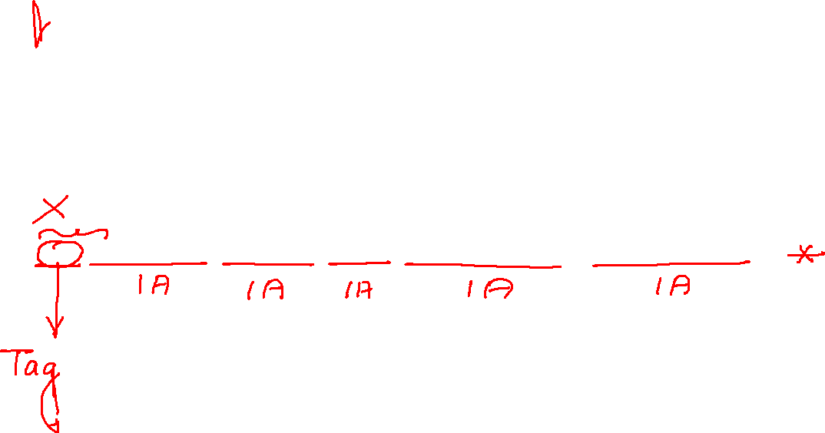
<input type="password" name="pwd" value="" class="textField pwdfield" placeholder="Password">

Slide 15

<input type="text" id="twotabsearchtextbox" value="" name="field-keywords" autocomplete="off" placeholder="" class="nav-input nav-progressive-attribute" dir="auto" tabindex="0" aria-label="Search">

Slide 16


Slide 17
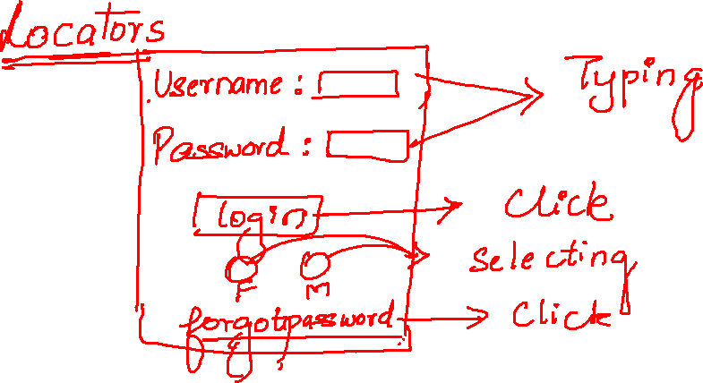

Slide 18
